Slide 1
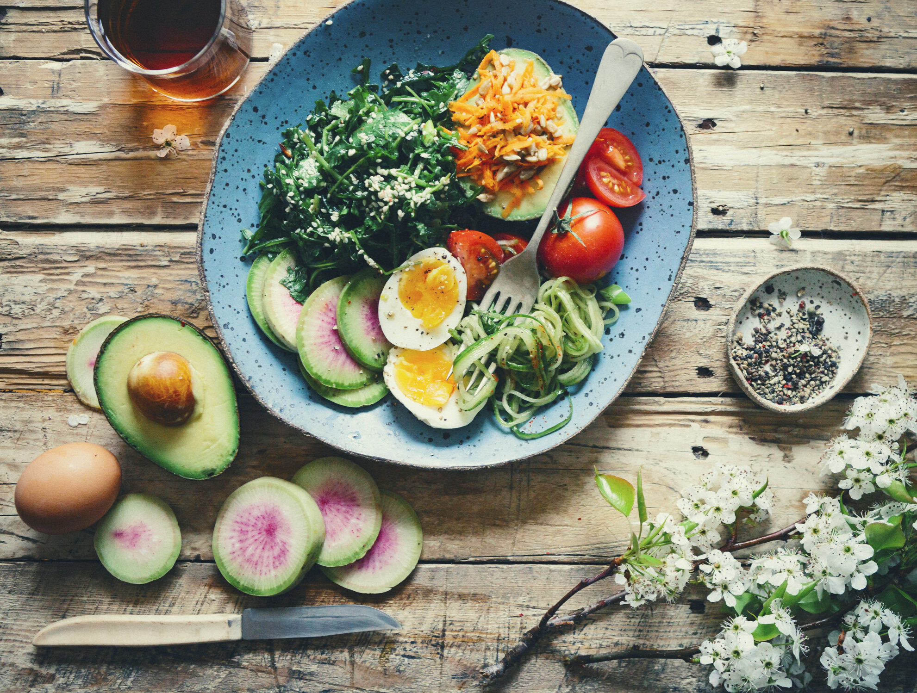
THE STUDENT HUB
BY JAVA & </Script>
PRESENTED BY
ARSANY FAHMY​
JOHN PARAGAS
​SHIVAM VEERABUDREN​
NEVRUZ UGAN
SHARJANAN STANICULAS
​ALEX P. TORCHON​
MARYAM ESKANDARI​

Slide 2


LOGO & GENERAL ENQUIRIES
​Team Name: Java & </Script>​​
Website Name: Student Hub
​​Industry: Restaurant​​
Client: Student Hub
​​Theme: Professional appearance, Interactive and User-friendly​

Slide 3
PROBLEM OVERVIEW
Lack of Online Presence​
Missing opportunities to reach a larger clientele​
Competition already has websites
​Lack of information for potential clients​
COVID-19-related issues

Slide 4
PROBLEM OVERVIEW
Why a Website?​ Bigger reach​
More client interactions​
Better client experience
​Easier access for information​​​​​

Slide 5
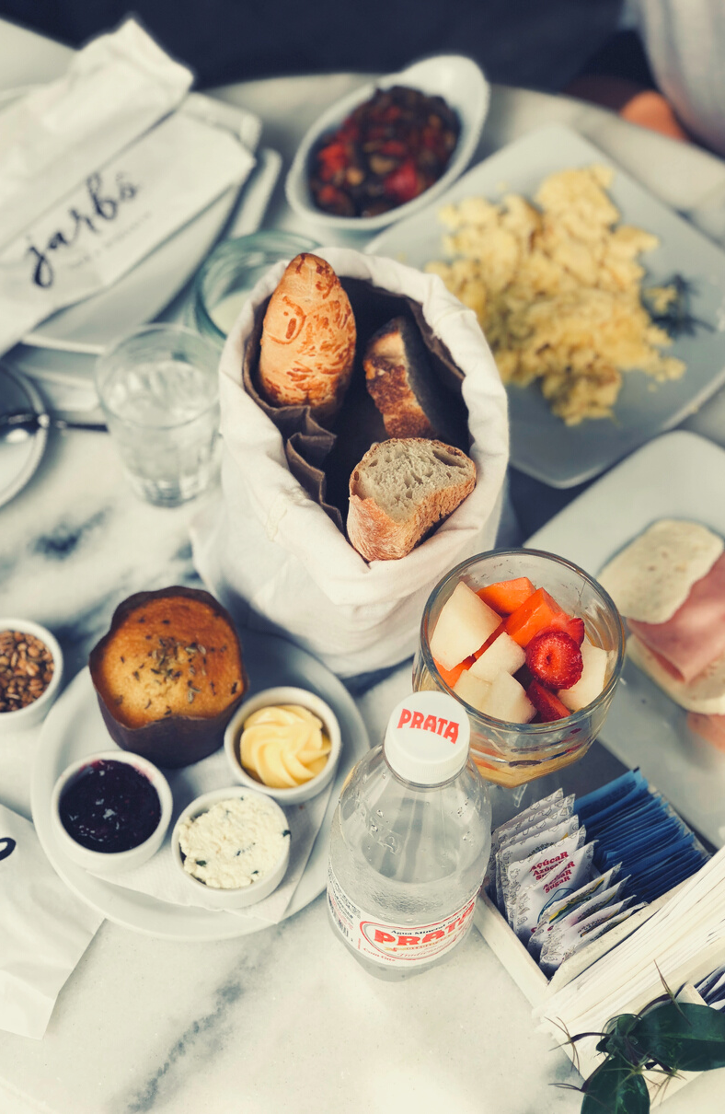
PROPOSED
SOLUTIONS
FUNCTIONALITIES
Display Menus​
Feedback ​
Delivery​
Table Reservation possibility
​COVID-19 Info Page
​Link to social medias ​​

Slide 6
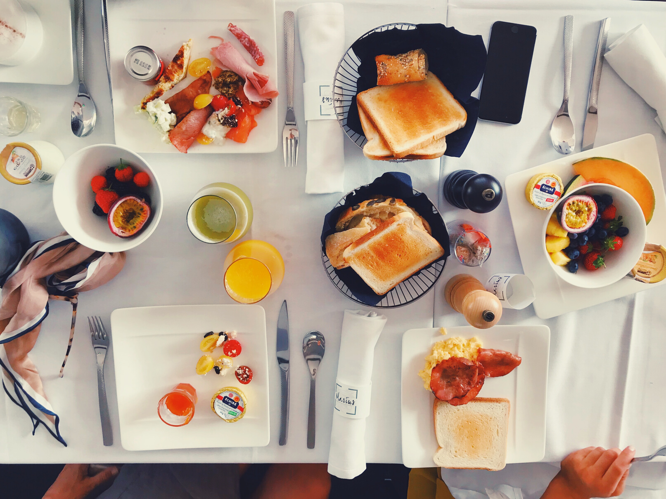
PROPOSED SOLUTIONS
DESIGN STYLES
Simple & Intuitive Layout
Headers at the top left of the page​
Medium-priority links on top right of the page​
Lower-priority links at bottom of page​​
Simple color pallet (3-4 colors)​
Accent color on top & bottom spaces
All the rest in white
​​Pictures to emphasize the product and/or establishment ​

Slide 7

DELIVERABLES
​Main Page
​Delivery / online​
Menus
Drink​
Food
Desserts
# of Pages​
10 Pages in Total
Table reservation
​Social Page​
About Us section ​
COVID-19 Info​

Slide 8
DELIVERABLES
Main page​
Delivery / online order page
​Menu
​Table reservation​
Social page​
Events​
Social media posts
​Feedback
​Register for discounts
​About us section​​​
COVID-19 Info

Slide 9
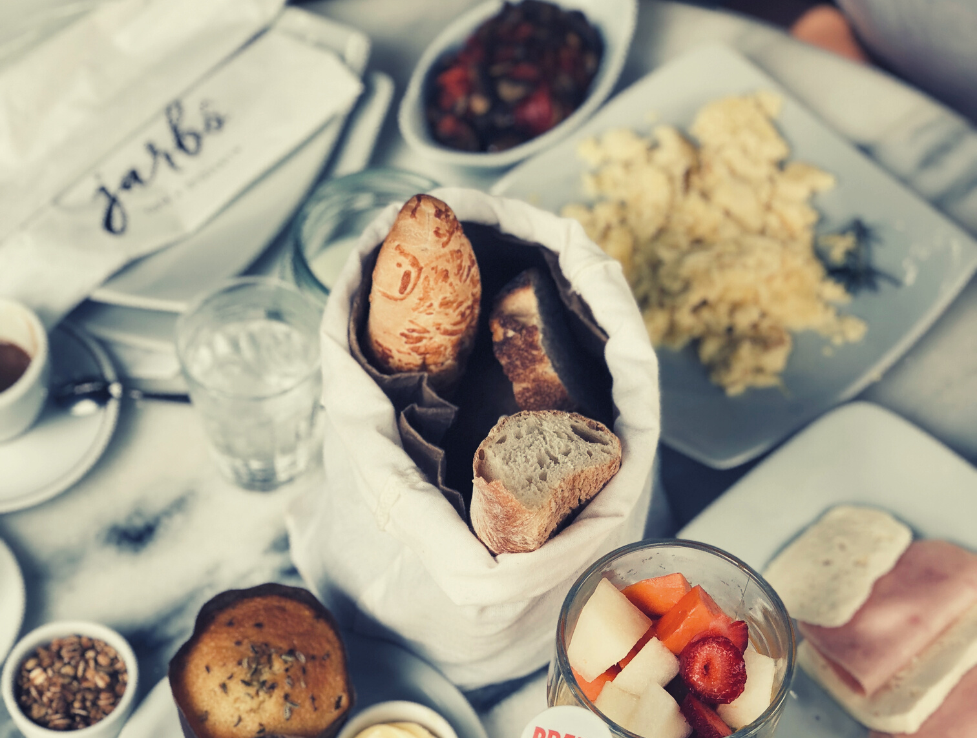
THANK YOU FOR YOUR TIME!

